Slide 1
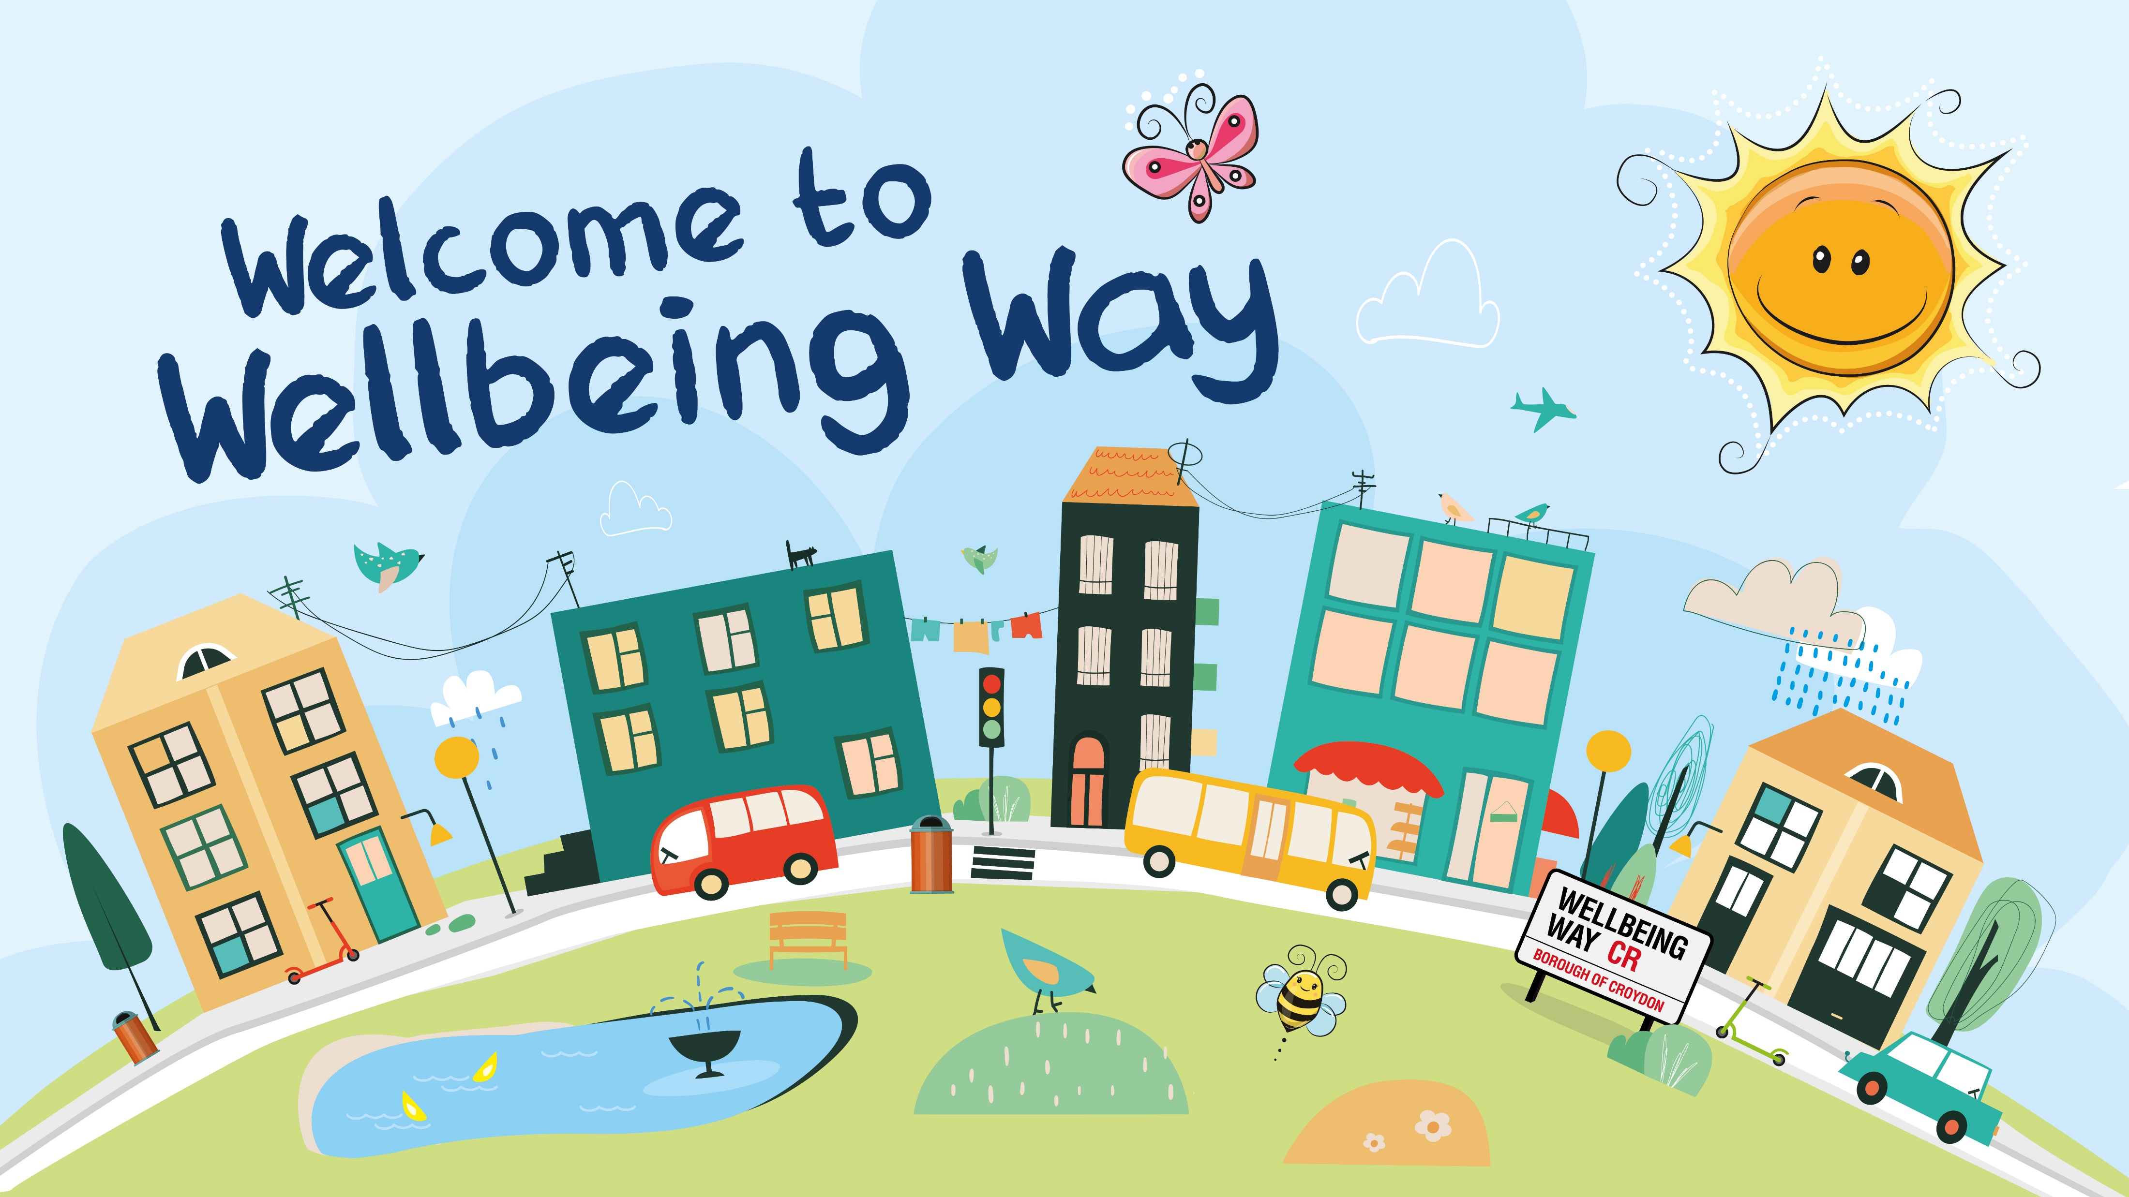
Notes:
Have any of you seen these characters before? Since 2021 children across Croydon have been getting to know them so that they can learn great ways to look after their wellbeing...

Slide 2
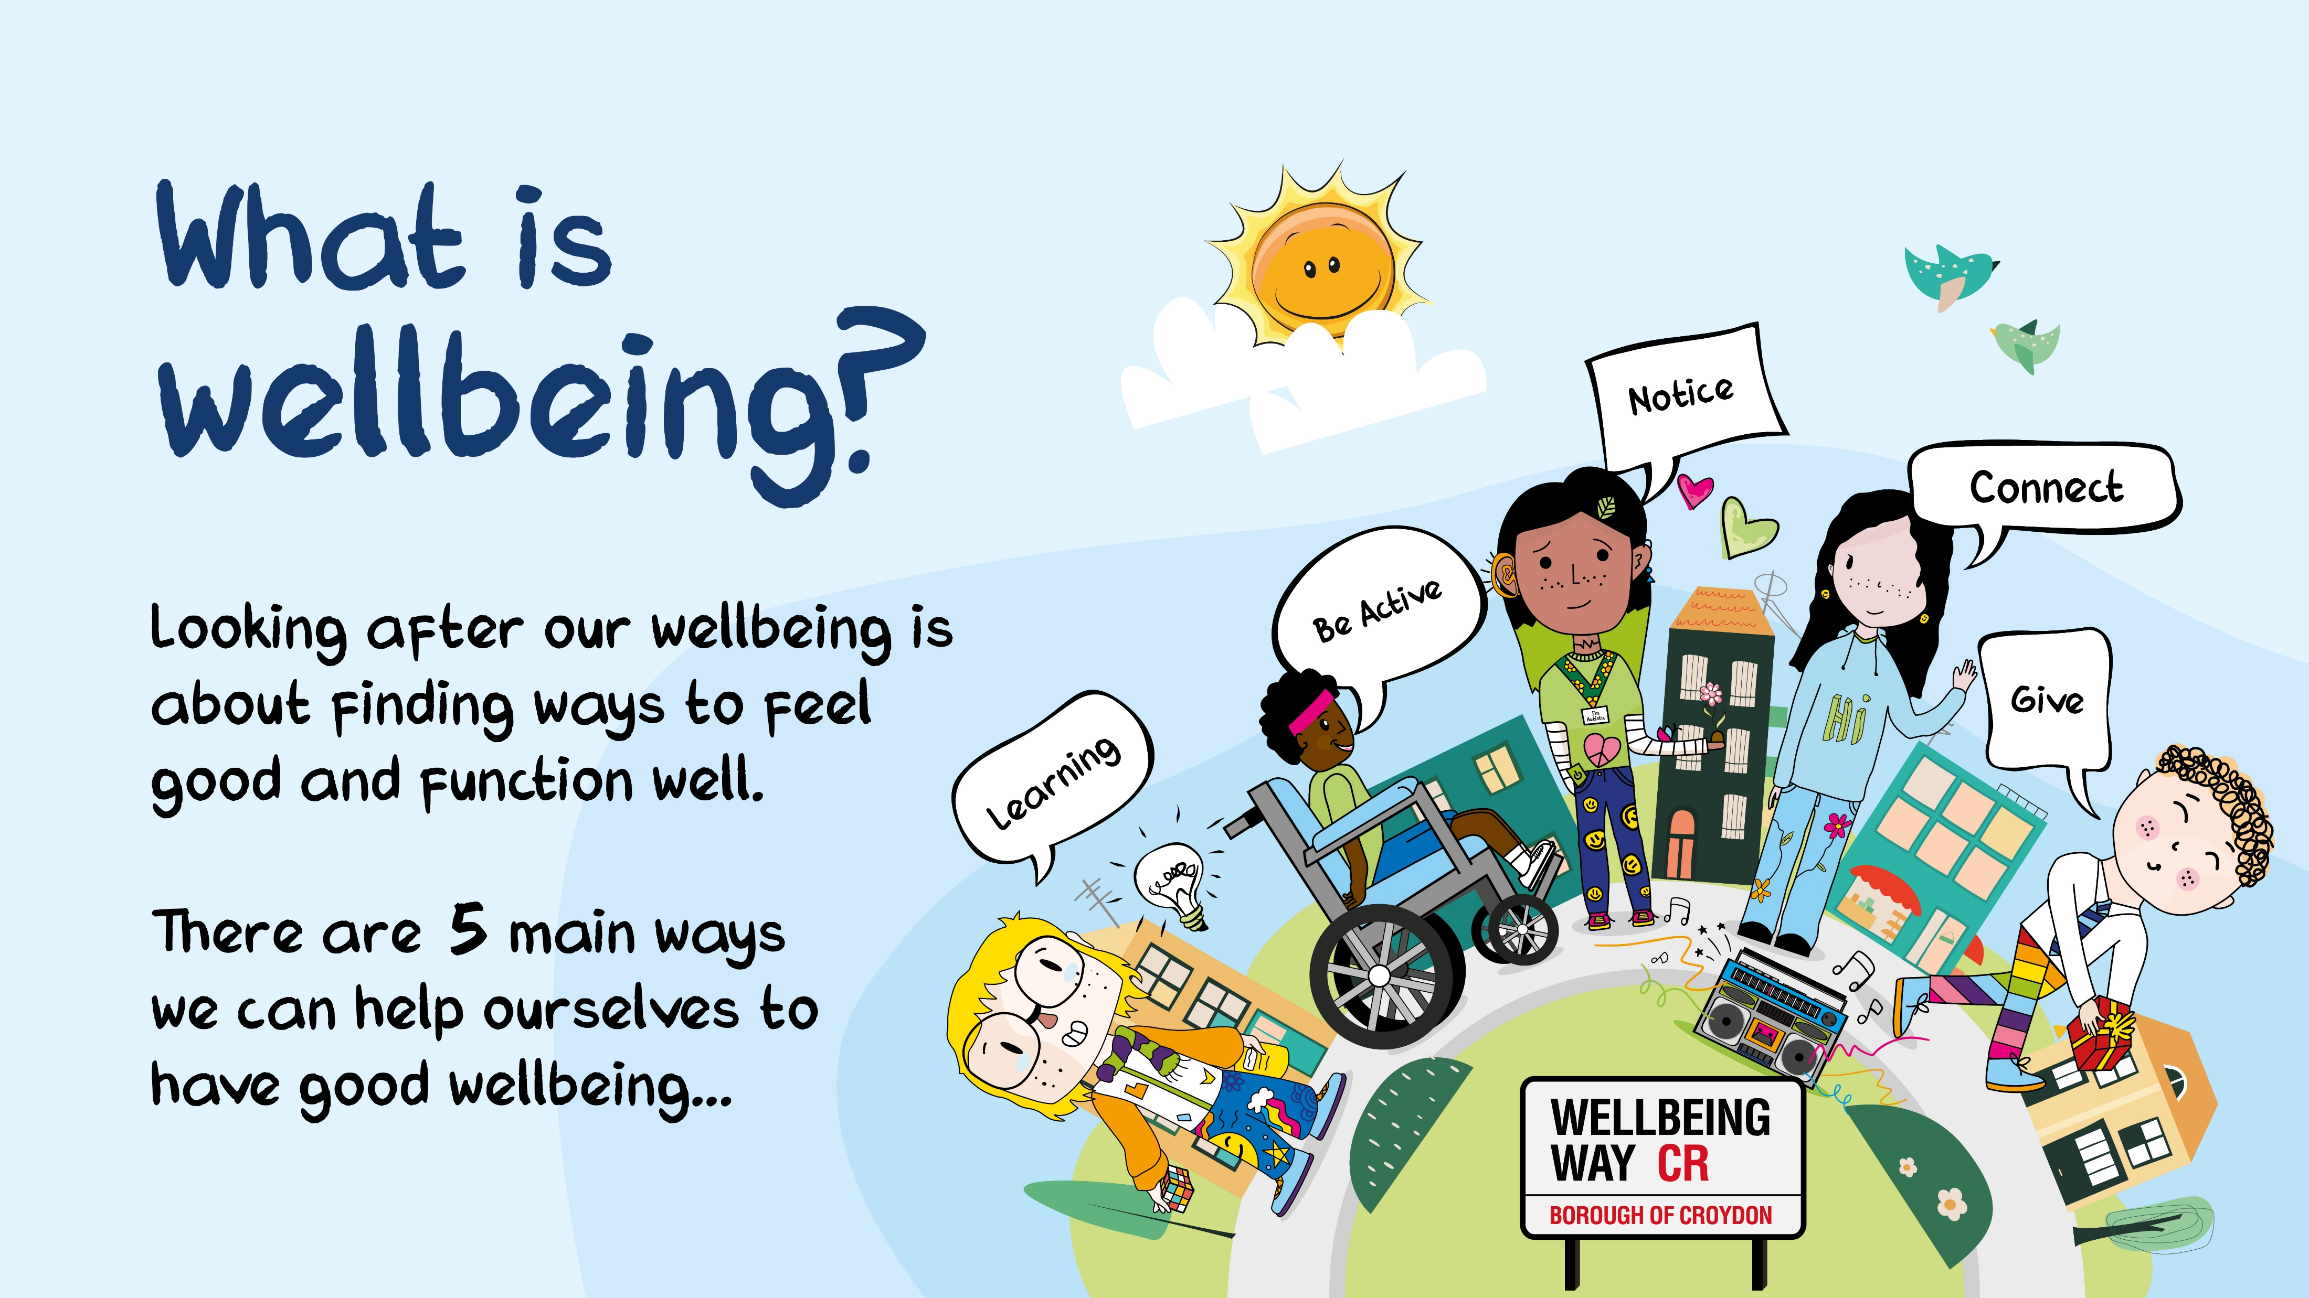
Notes:
Ask children to offer some ideas on what they think wellbeing is...

Slide 3
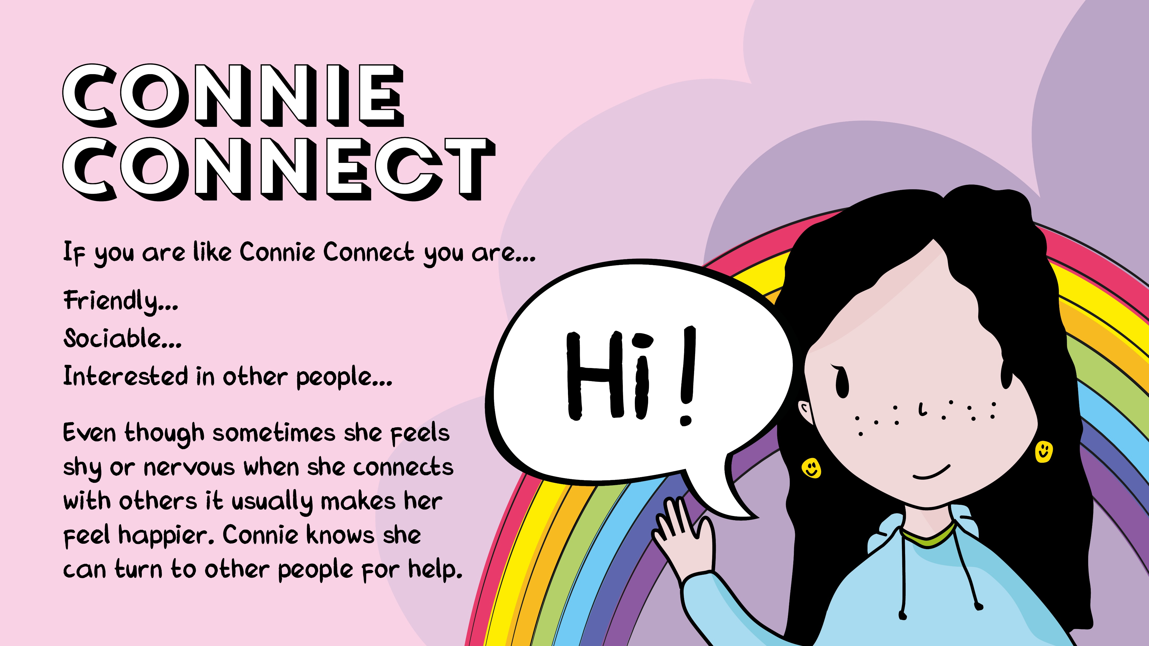
Notes:
Question: How do you connect with others?
Examples: playing skipping/clapping games, reading together, playing football together, playing in home corner together...
Question: Who do you turn to for help?
Examples: Mum, Uncle, teacher, doctor…

Slide 4
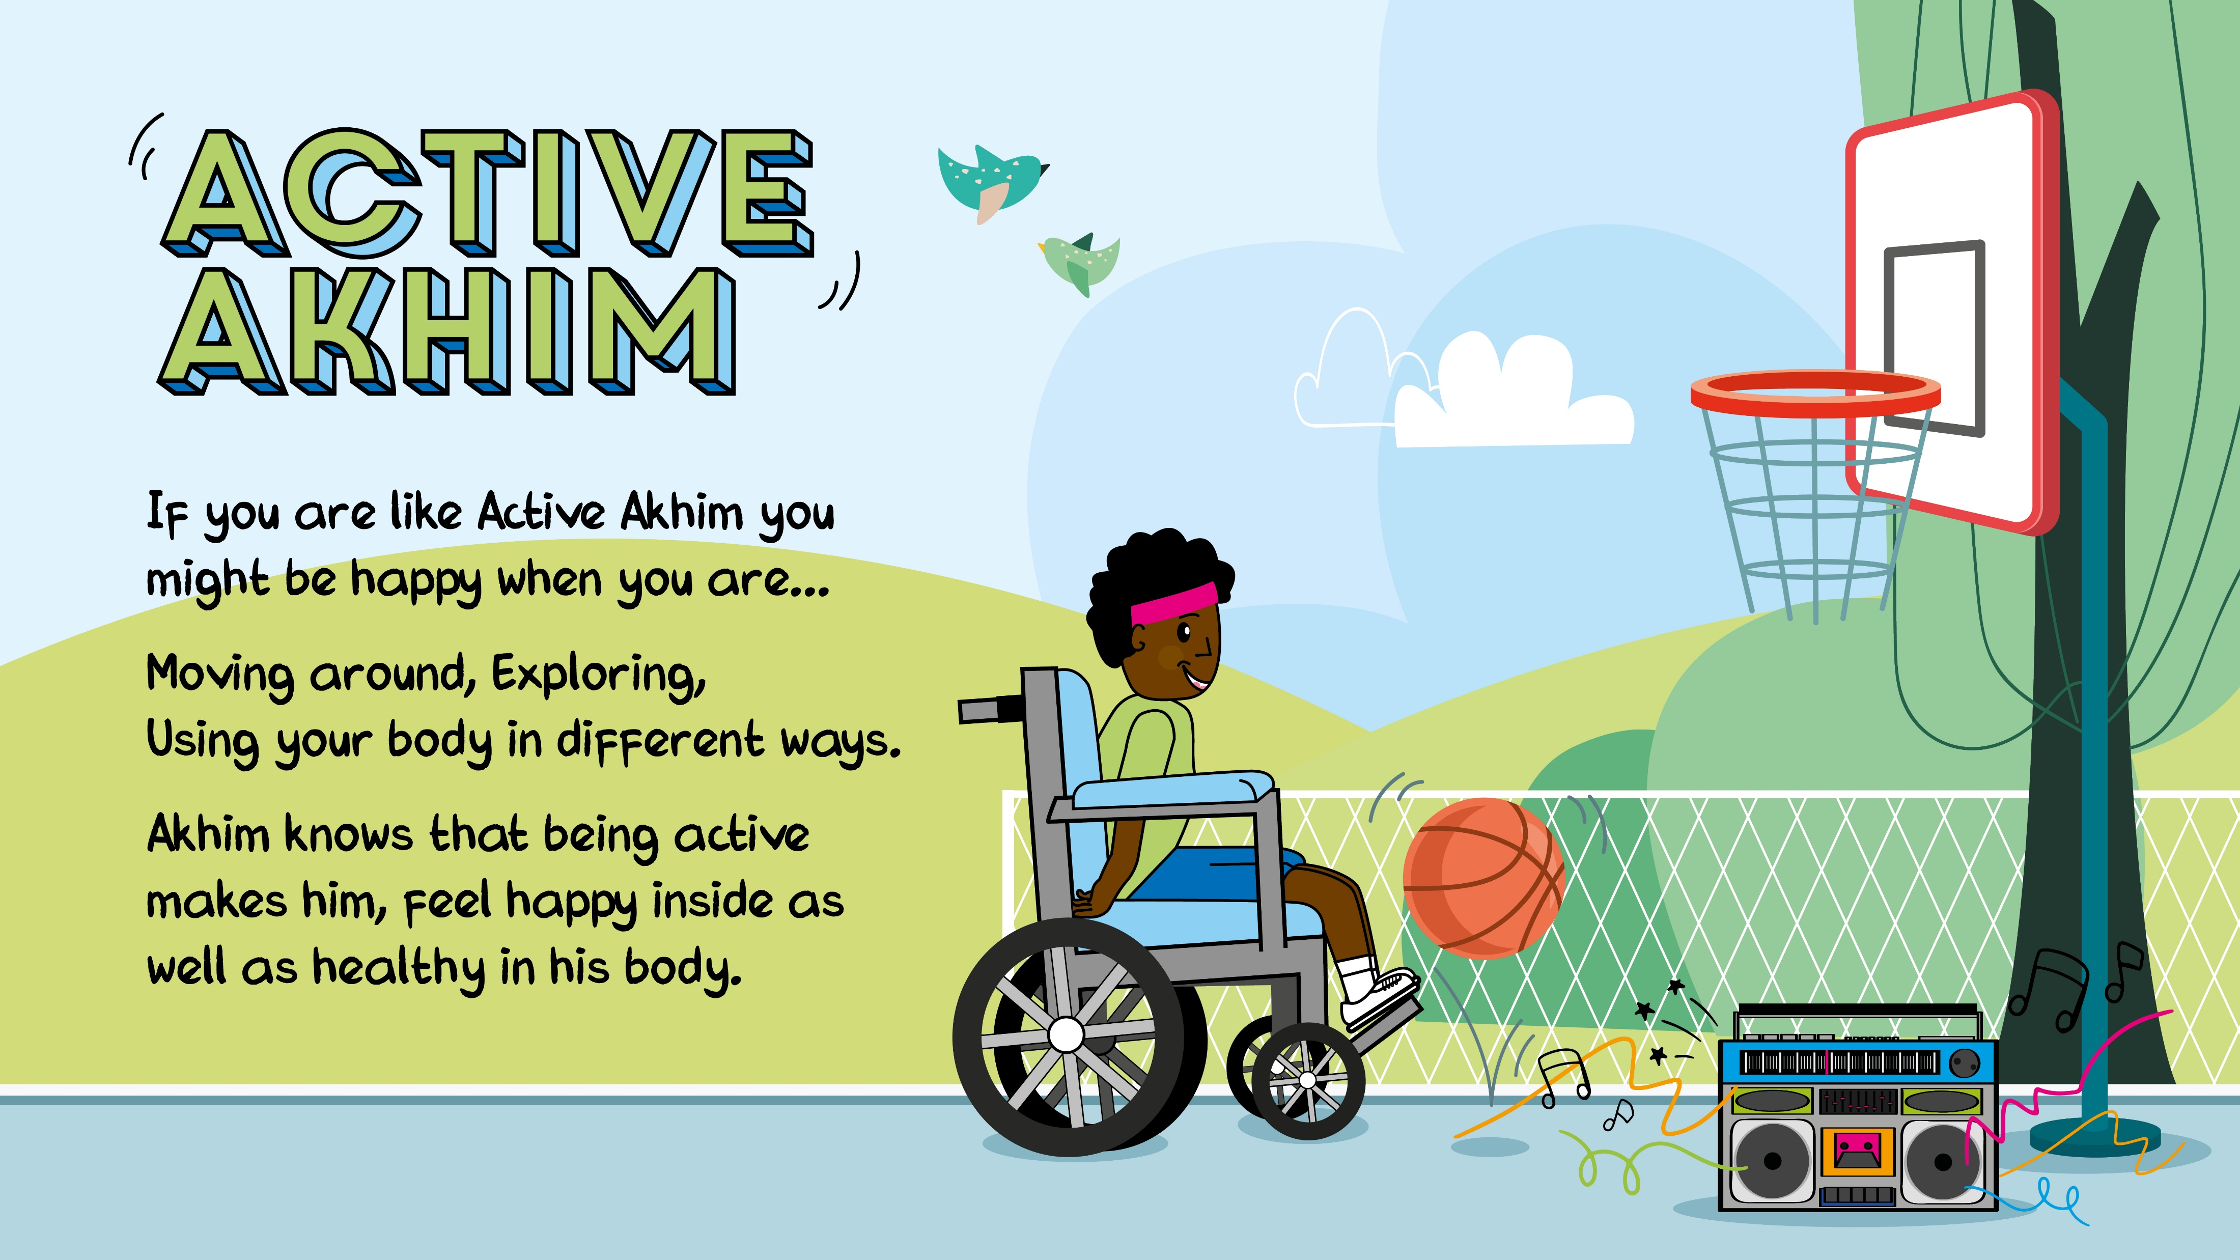
Notes:
Question: What kind of things might you do to be active?
Examples: Swim, scoot, play football, gymnastics…
Question: How can we use our bodies to travel?
Examples: cycle, walk, jog…
Exercise: Take a deep breath in and raise your shoulders up towards your ears
Release breathe out and let shoulders relax down
Even simple movements like this can refresh us!

Slide 5
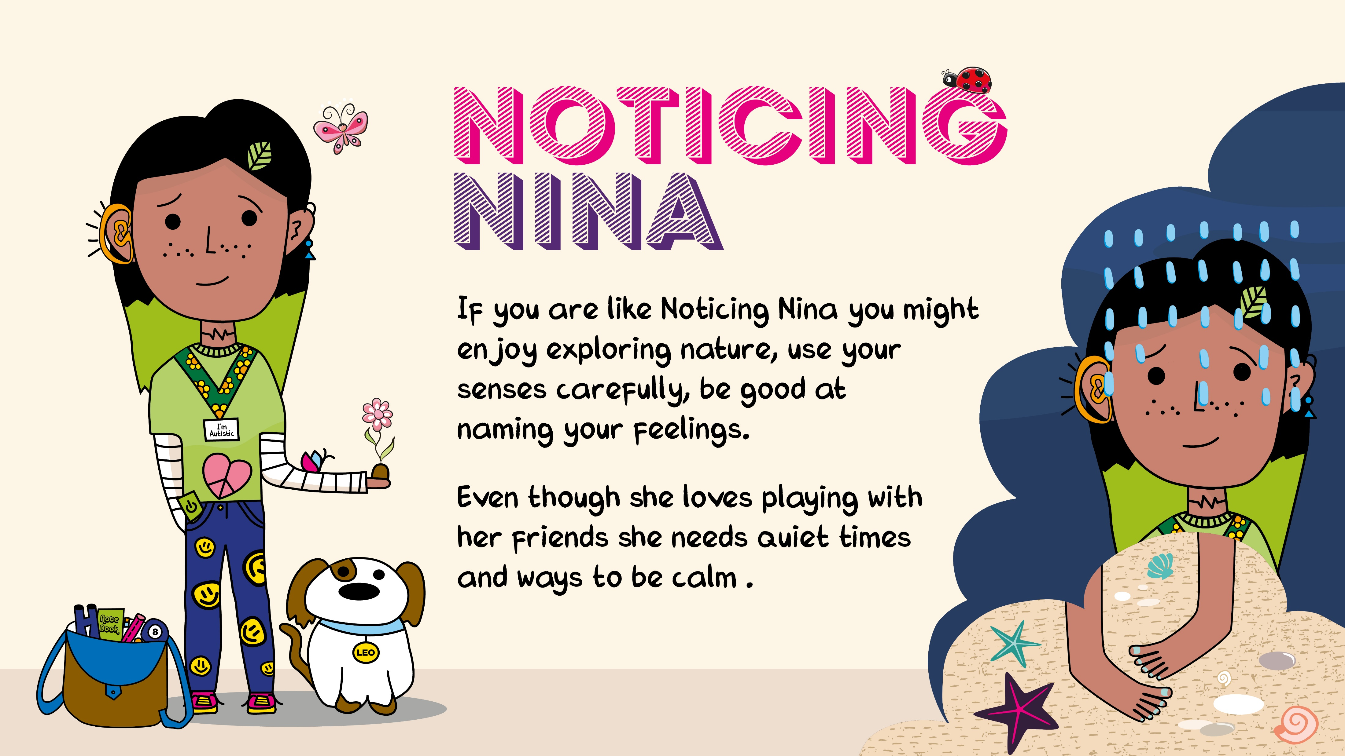
Notes:
Question: Can you name some emotions?
Examples: Happy, excited, frustrated…
Question: What do you do to that calms you down?
Examples: Bug hunting, playing in sand, yoga, breathing exercises, eating food mindfully, watching the clouds

Slide 6
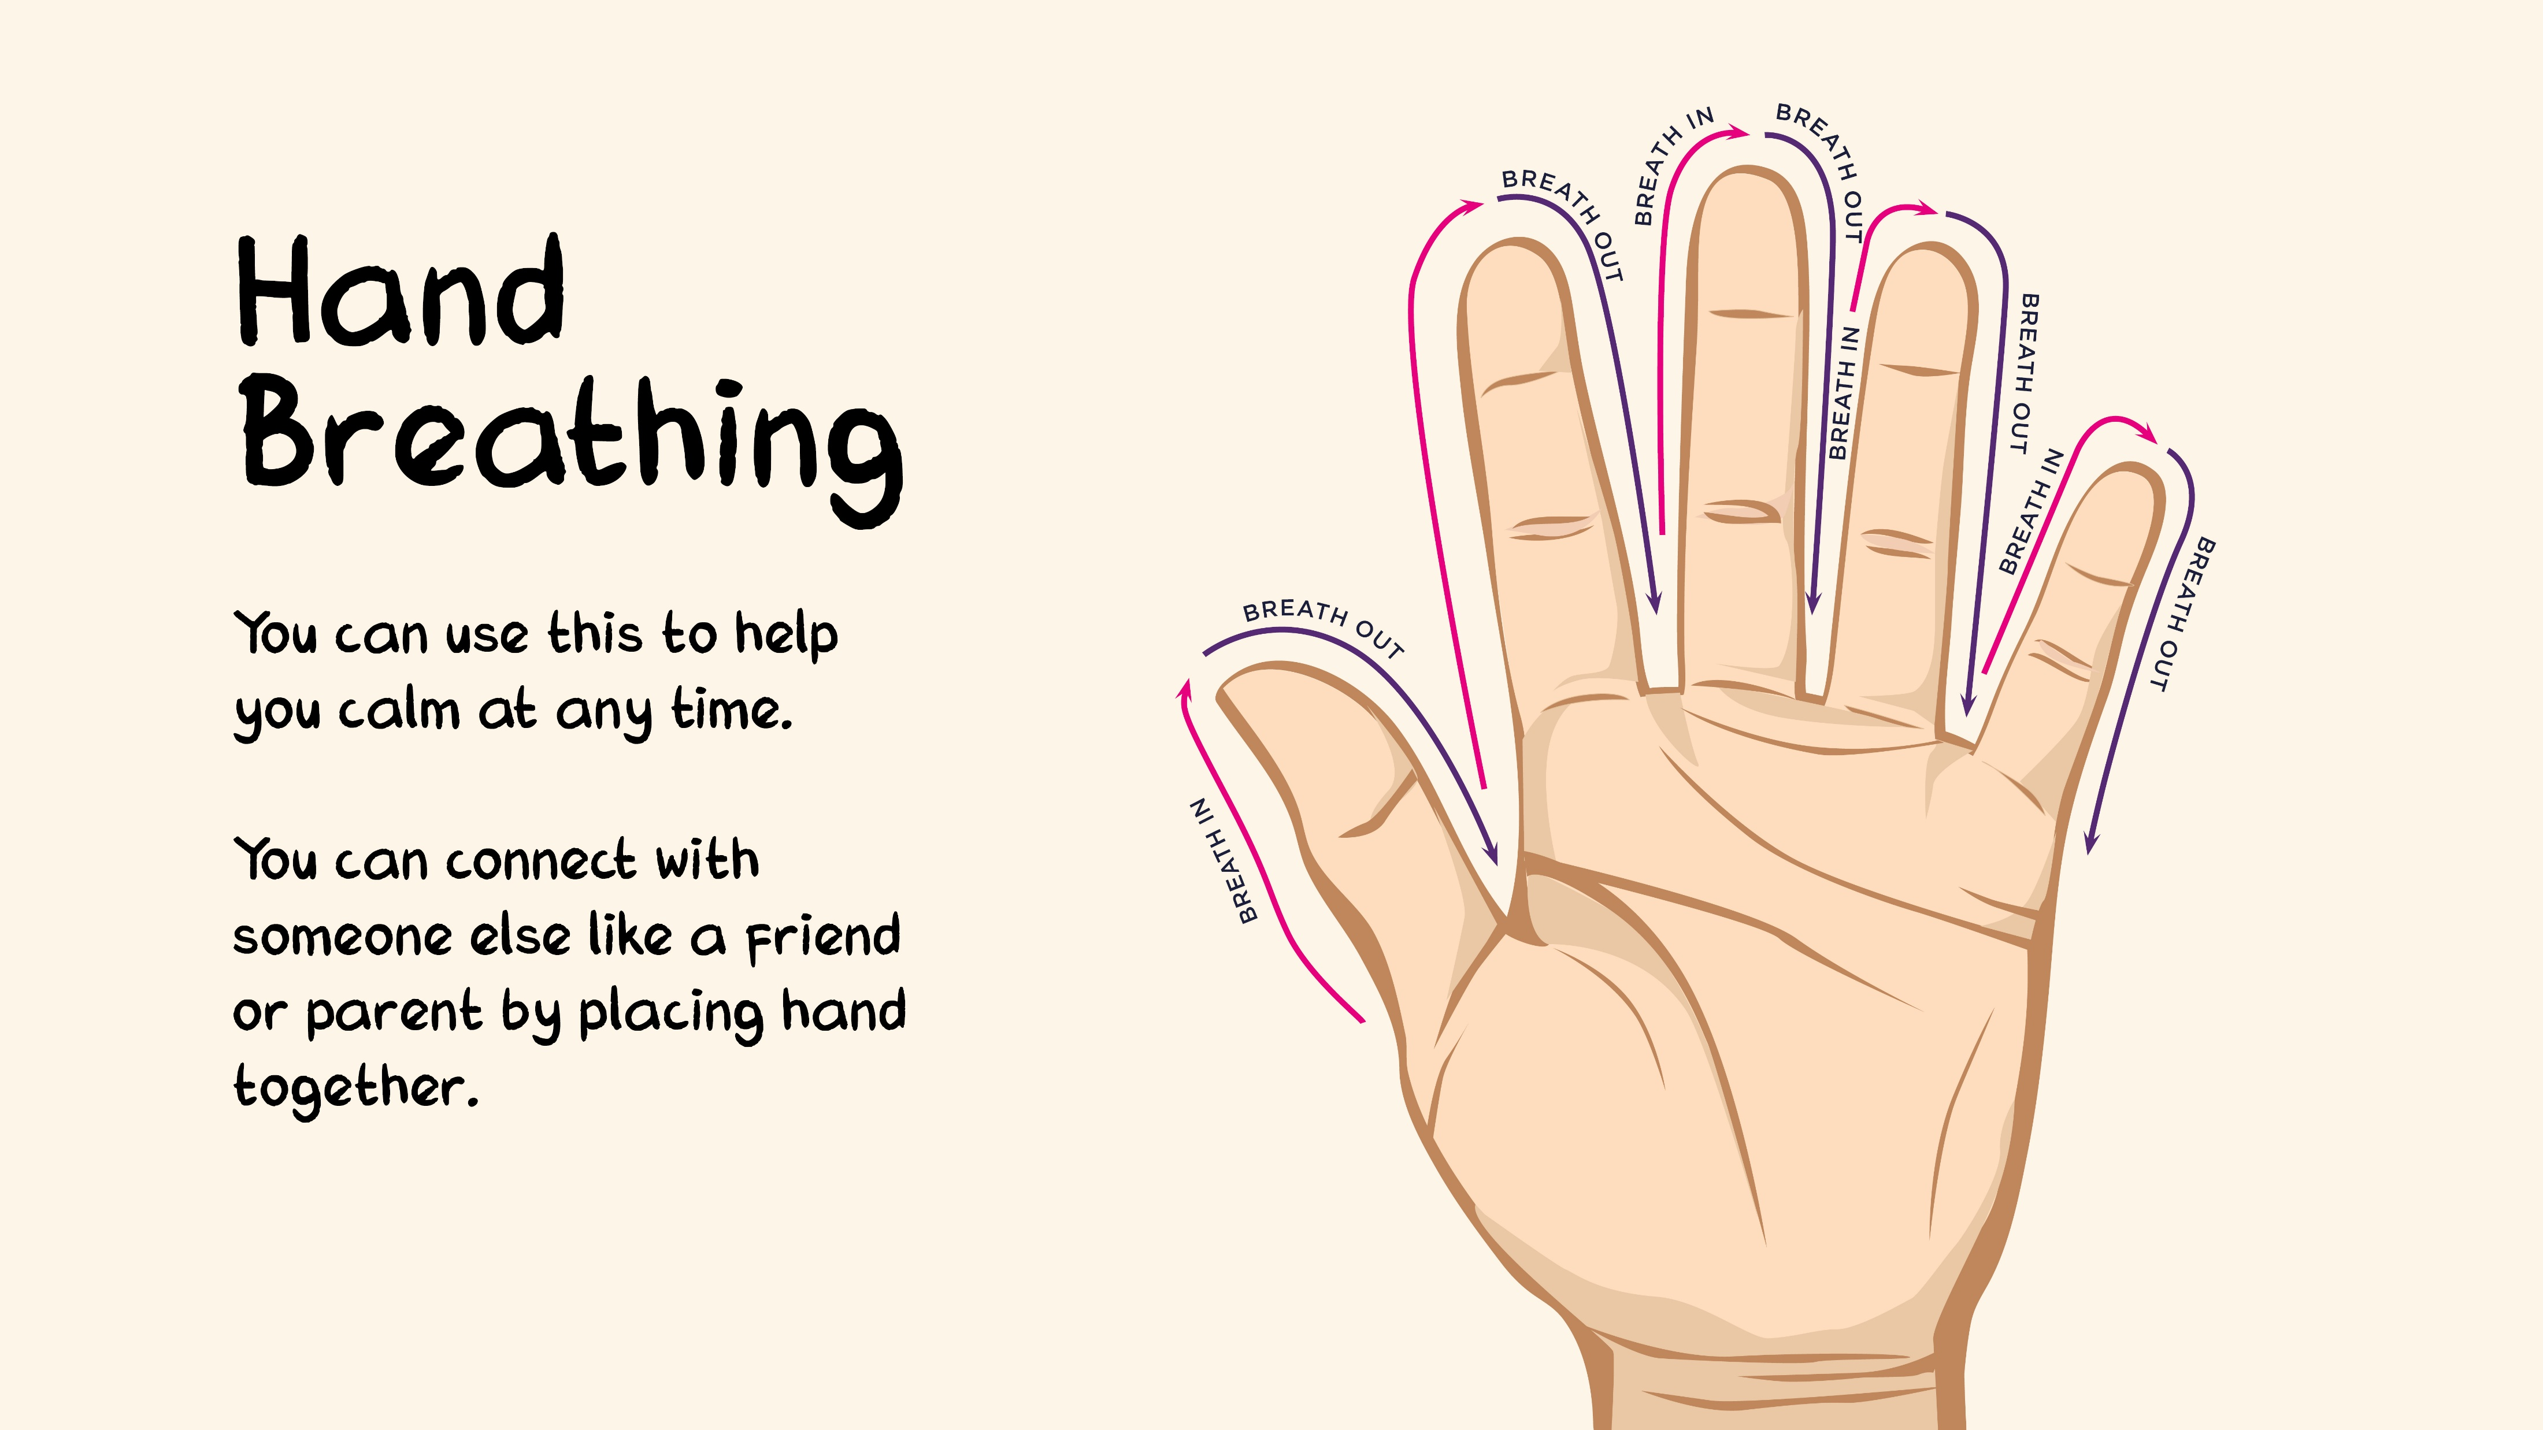

Slide 7
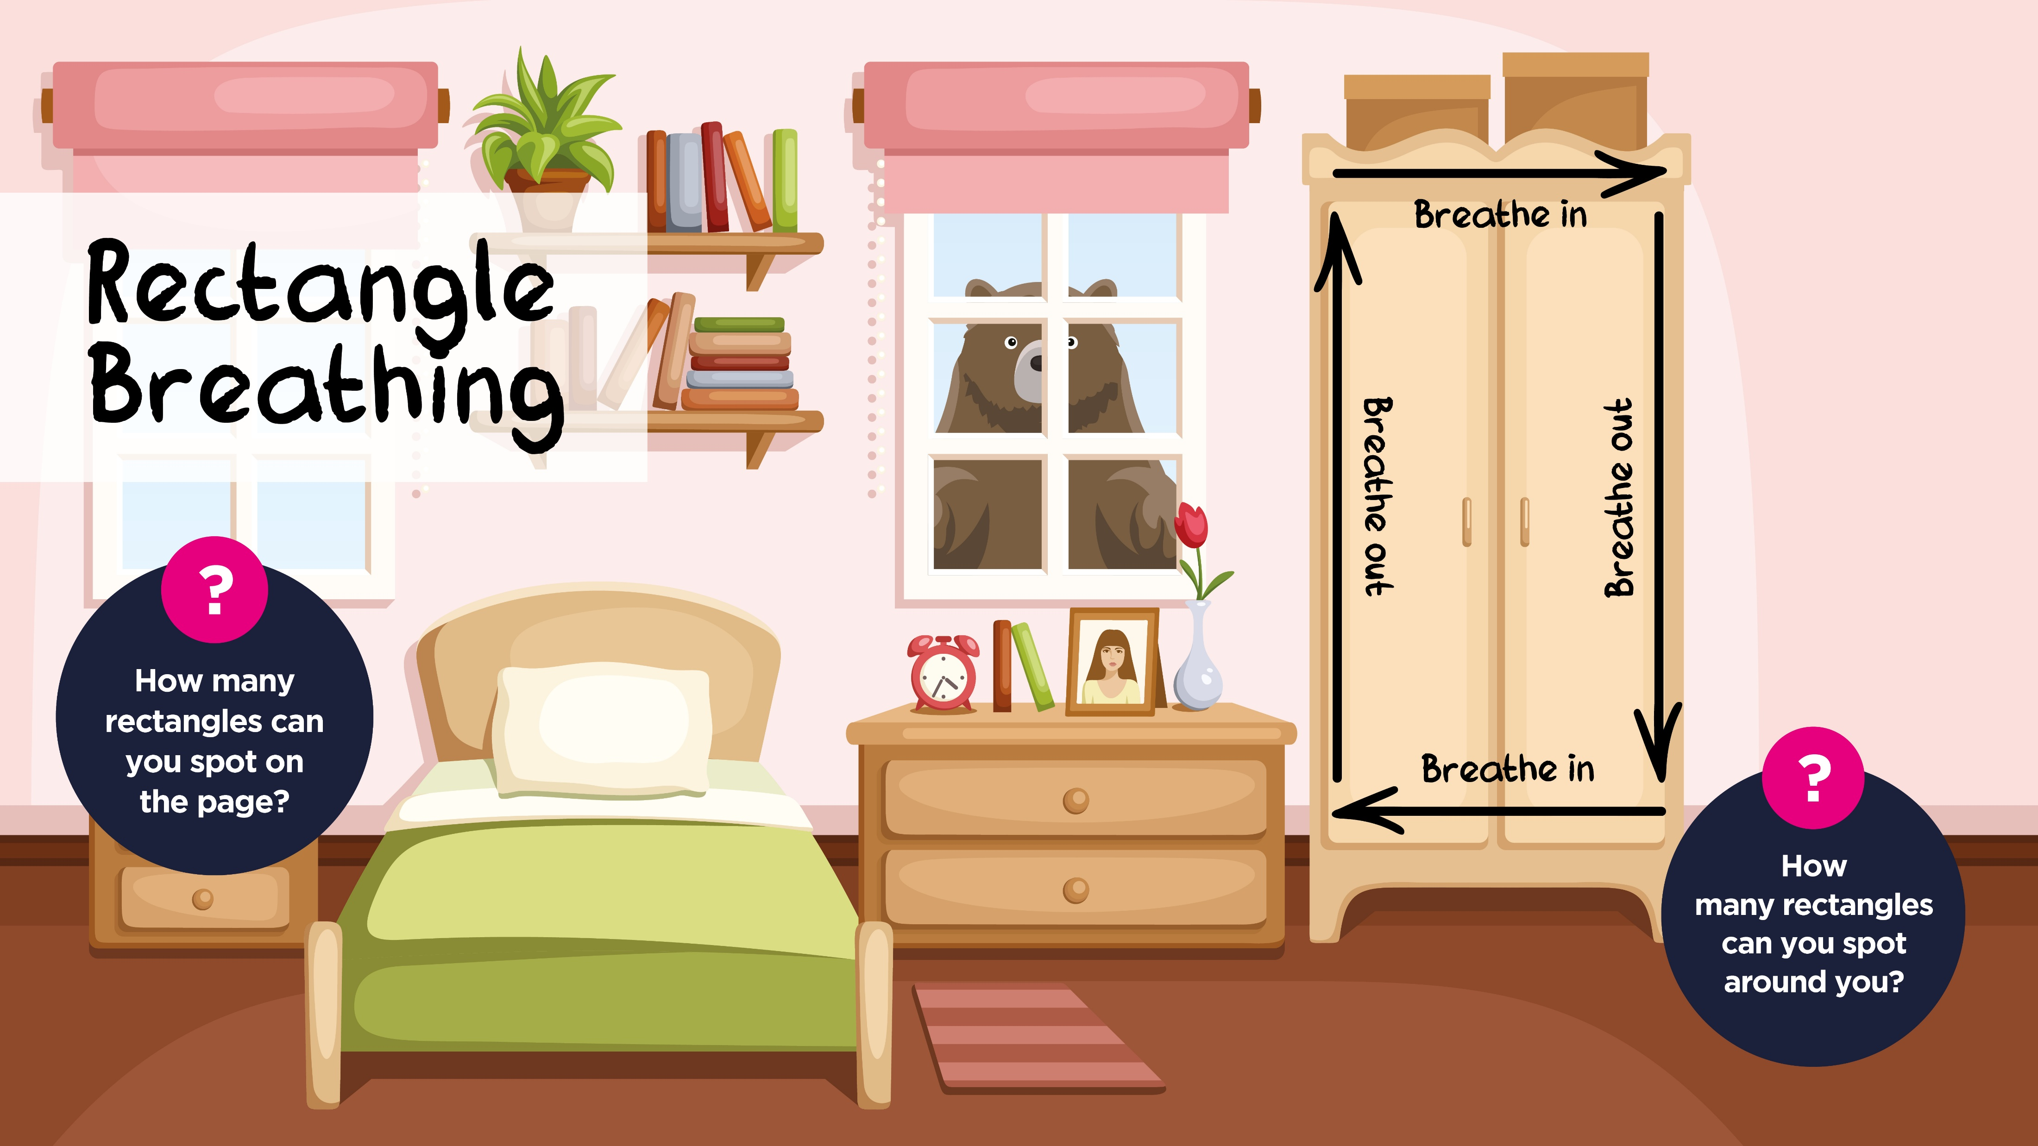
Notes:
Insert in notes:
When we start to panic our brain does not know whether there is a real danger (the bear) in front of us or a danger in our minds- we start to pant, sweat, tremble- all natural survival mechanisms- if we take long breathes out we tell our brain the danger is gone and we begin to calm.
Once we have helped ourselves to calm down, we can think more clearly and begin to solve problems.

Slide 8
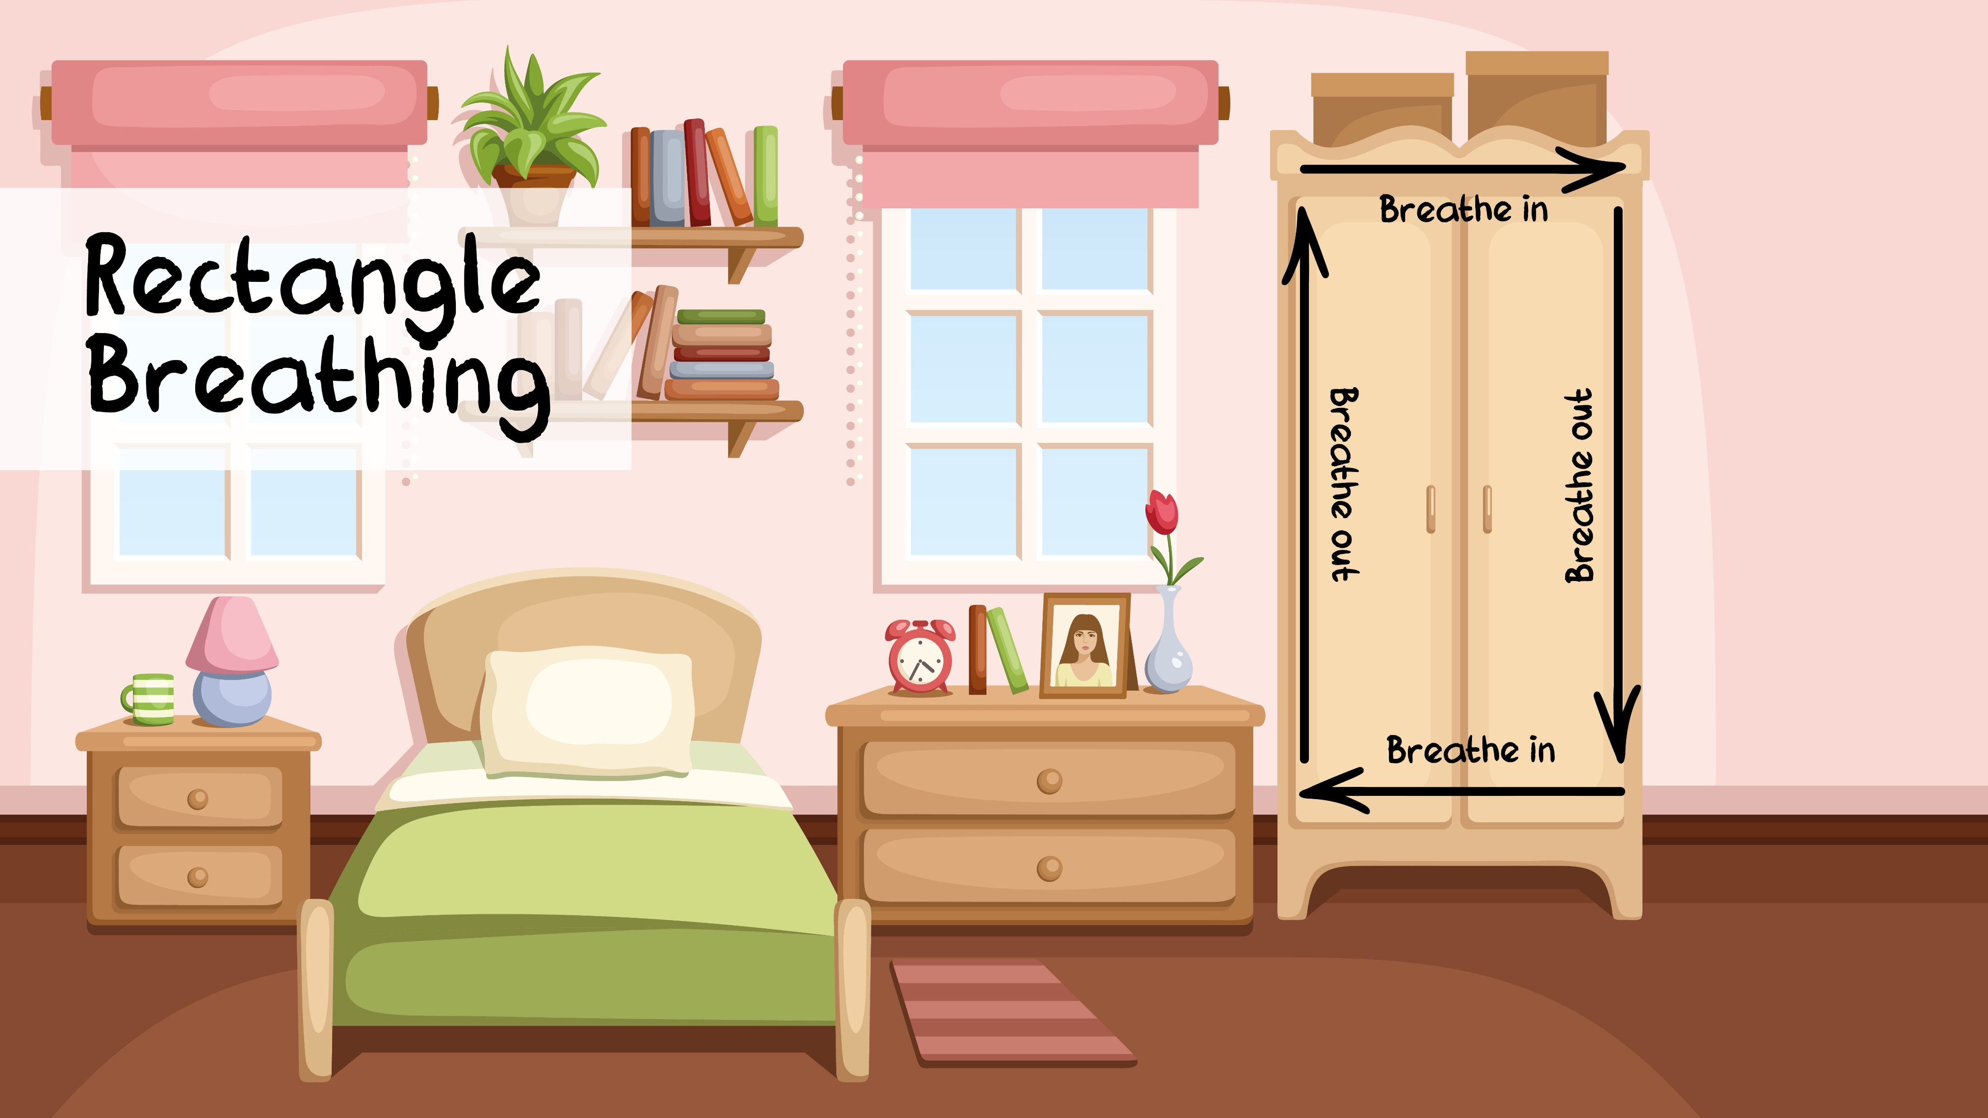

Slide 9
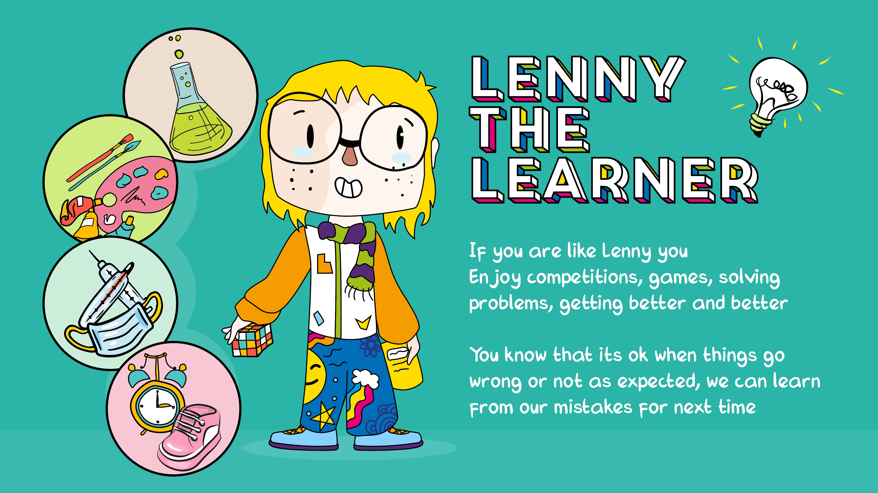
Notes:
Question: What are you enjoying learning?
Examples: tying laces, science experiments, scoring goals
Question: How does it feel when you lose or fail?
Examples: frustrating, annoying, upsetting

Slide 10
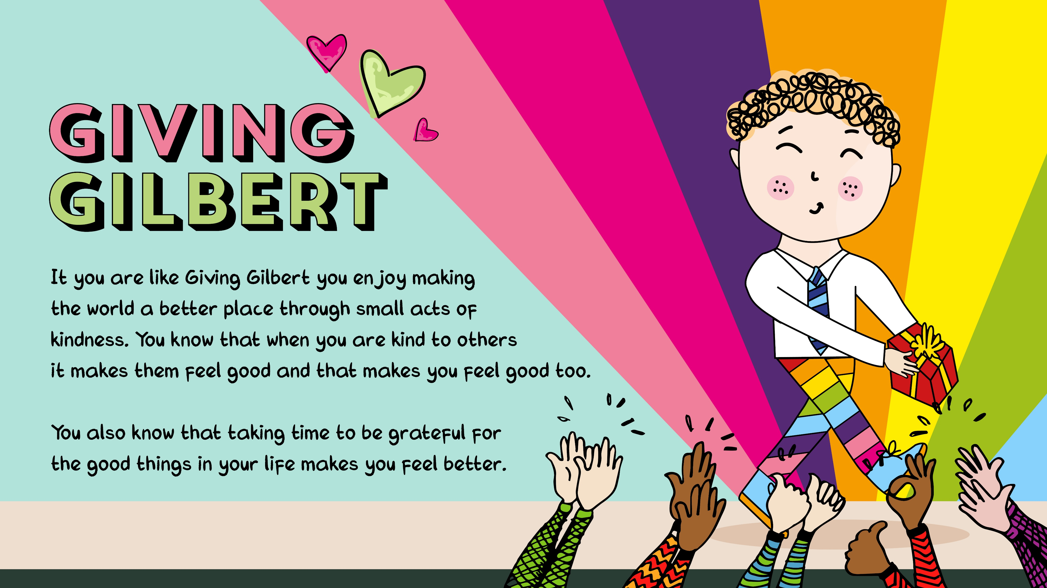
Notes:
Question: What do you do that is kind?
Example: Cuddle my sister, help my teacher, help with the washing up, put my litter in the bin
Question: What are you grateful for?
Examples: my birthday present, my brother, my friend, my teaching assistant, my new shoes…
Another breathing exercise - Wrap your arms around yourself in a cuddly ball as you breathe in, let your arms and body flop as you breathe out...

Slide 11
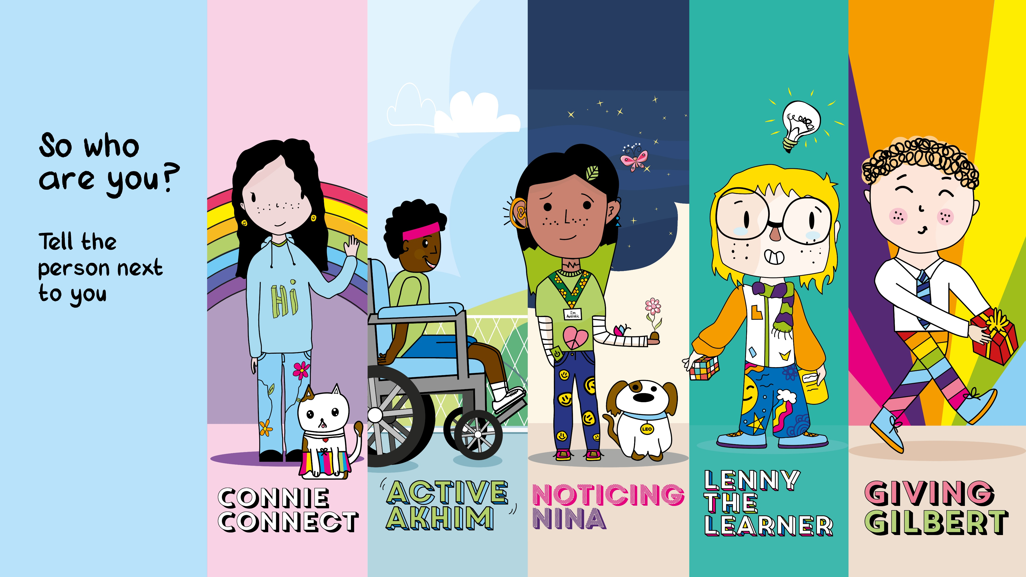

Slide 12
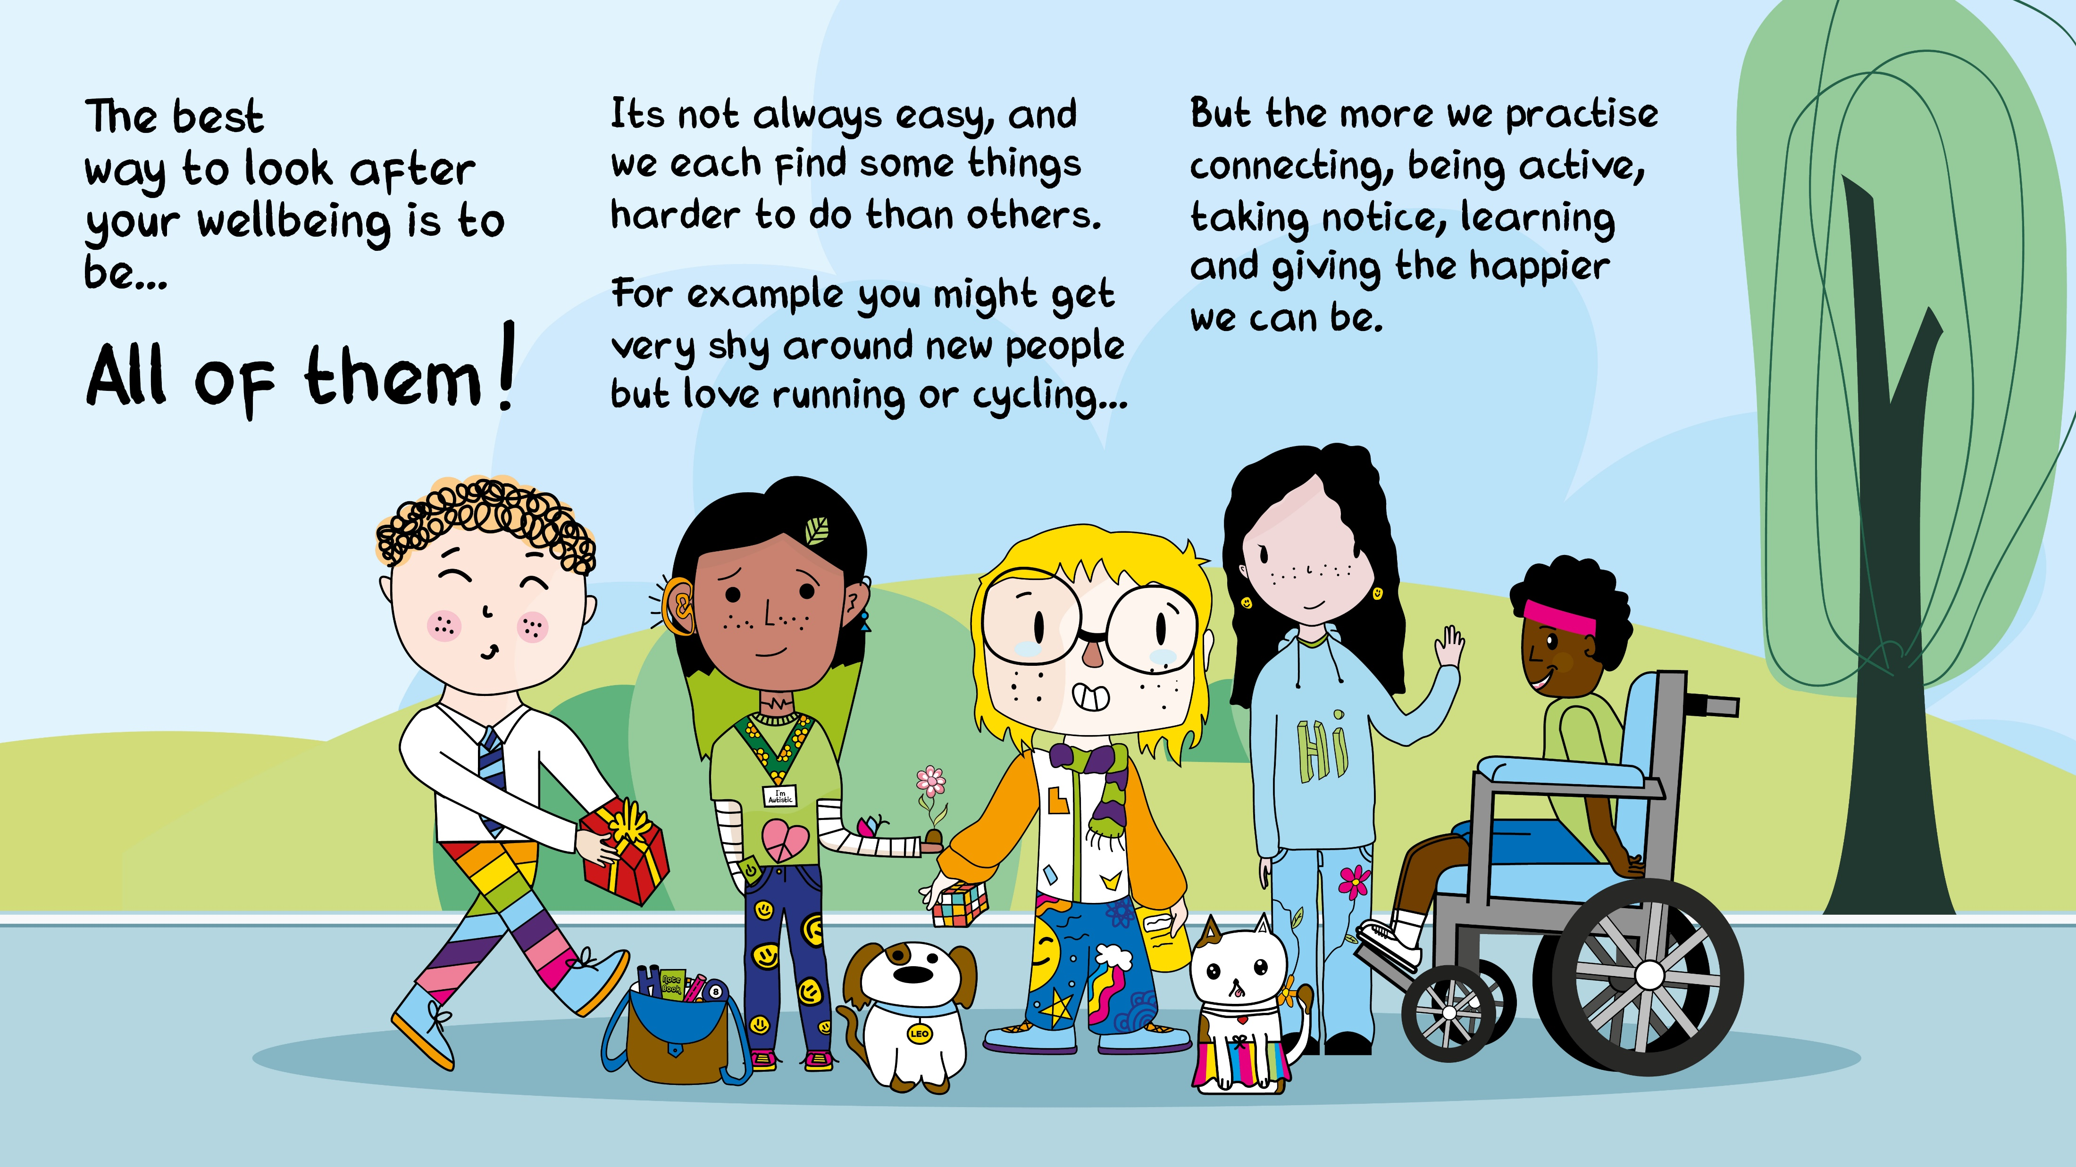

Slide 13
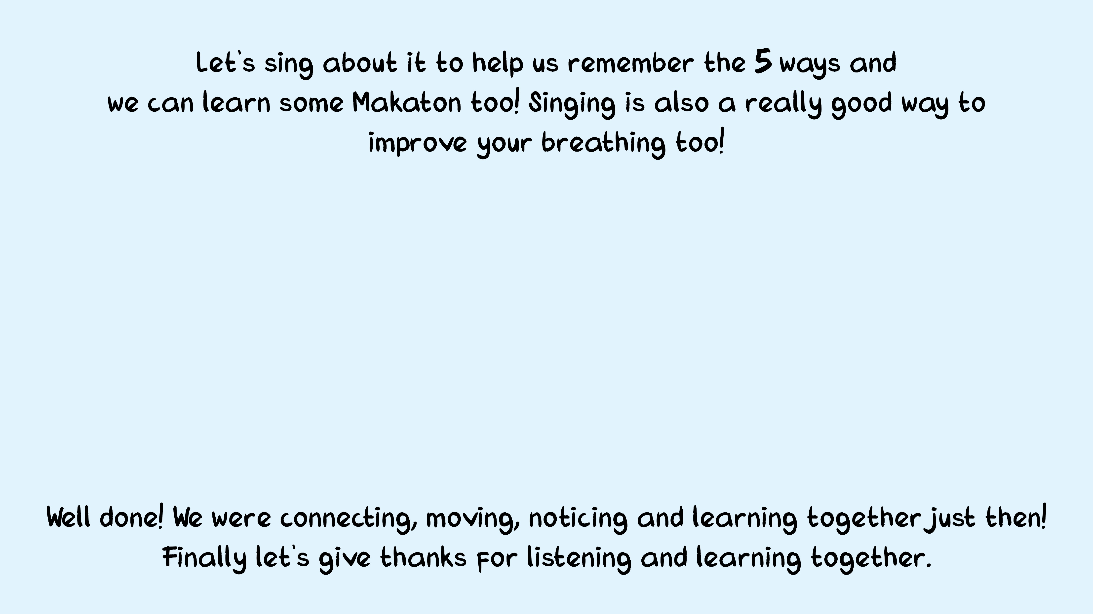
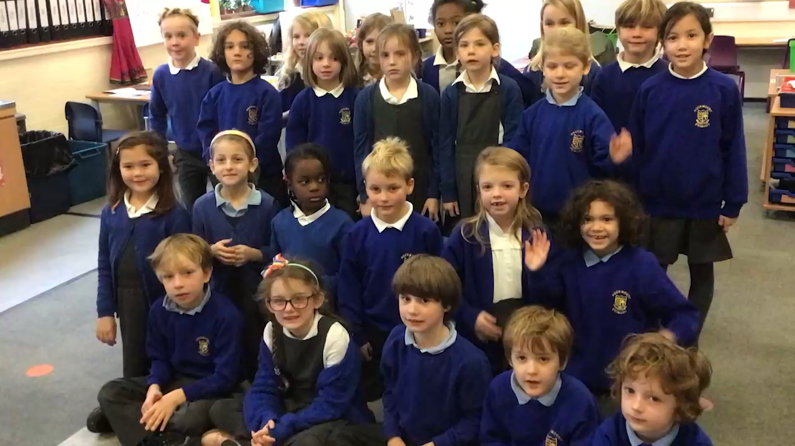
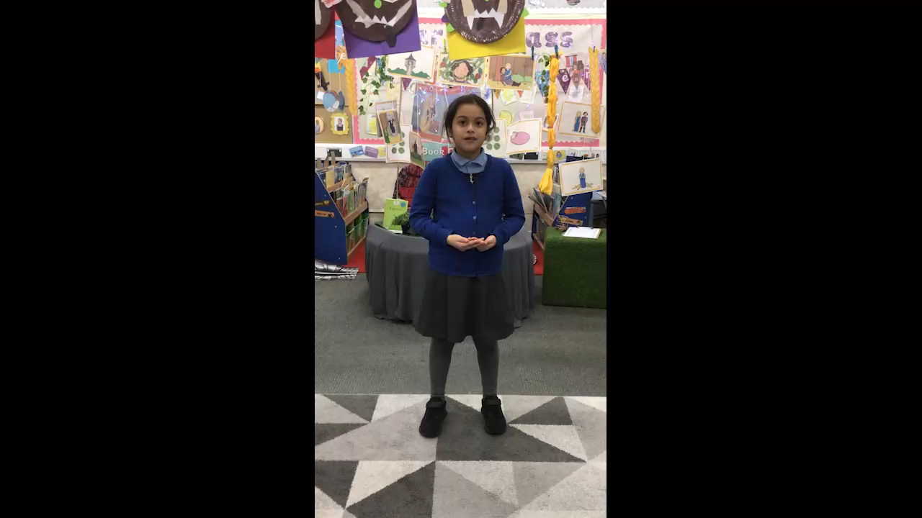
Notes:
Today when you are feeling good try to think about which one of the 5 ways you are doing. If you aren’t feeling good thing about the 5 ways and see if you can find a way to make yourself feel better!

Slide 14
