Slide 1
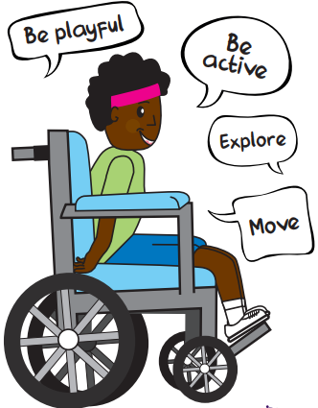

Wellbeing Bingo
Do something healthy which makes you feel good. | Go for a brisk walk outside. | Make a healthy meal from scratch.
Choose to walk a longer route to get somewhere. | Try not to sit for more than 20 minutes without getting up for a short break. | Put on some music and dance.
Try out a new way of being physically active. | Stand rather than sit when you can today. | Set yourself a daily physical activity goal and try and stick to it for a week.
Tuesday's way to wellbeing is "be active". How many of Active Akhim's suggestions can you cross off today? Can you get a line or a full house?

